Slide 1


Delicacies of Observability: AWS OpenSearch Cluster from 'rare' to 'well-done'
Eugene Tolbakov

Slide 2

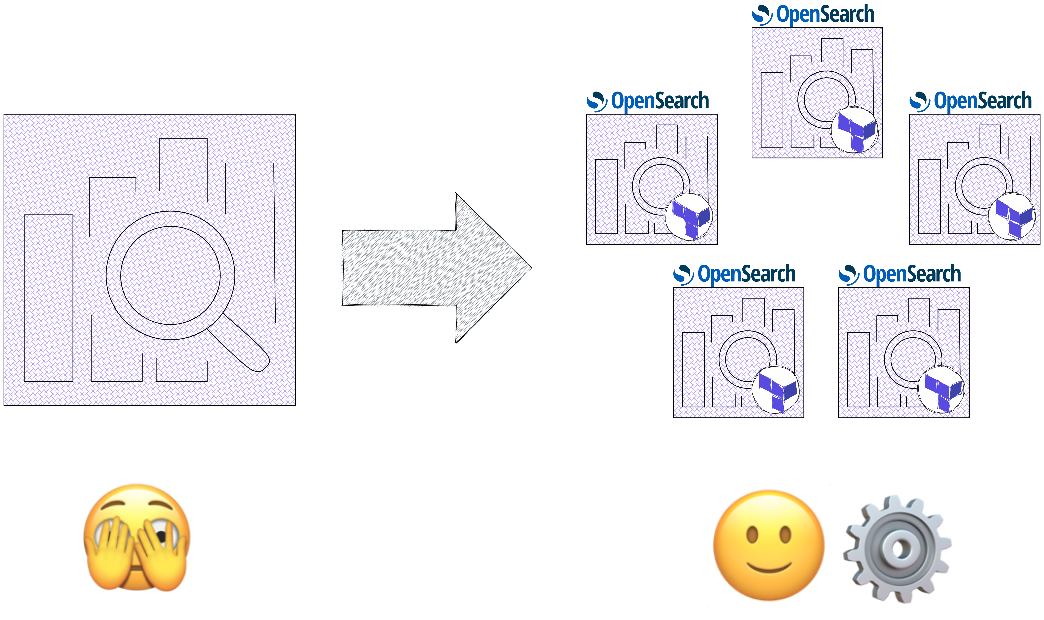



WHAT’S ON MENU
Starter:
From uber – cluster to 5 log-specifics clusters
Main Course:
IaC approach & overview of OpenSearch settings
Dessert:
Key learnings, insights & tips

Slide 3



DISCLAIMER

Slide 4
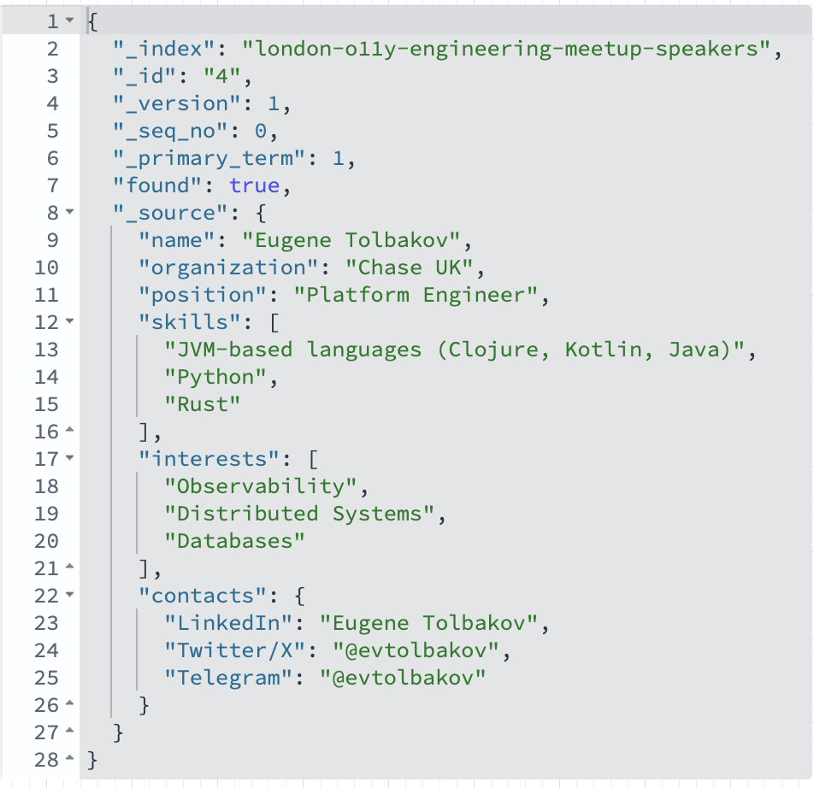

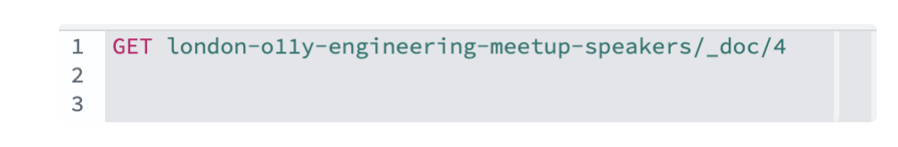
ABOUT ME
Notes:
• Chase launched in the UK in Sept 2021
• Over 2M customers (Chase and Nutmeg)
• £20B in balances (Chase and Nutmeg)
• Current accounts, savings accounts, digital wealth & investments
• Winners at the British Bank Awards in several categories*
• 4.1 Trustpilot (Chase, Sep 2023)
• 4.8 Google - 4.9 iOS App Store Ratings (Chase, Sep 2023)

Slide 5
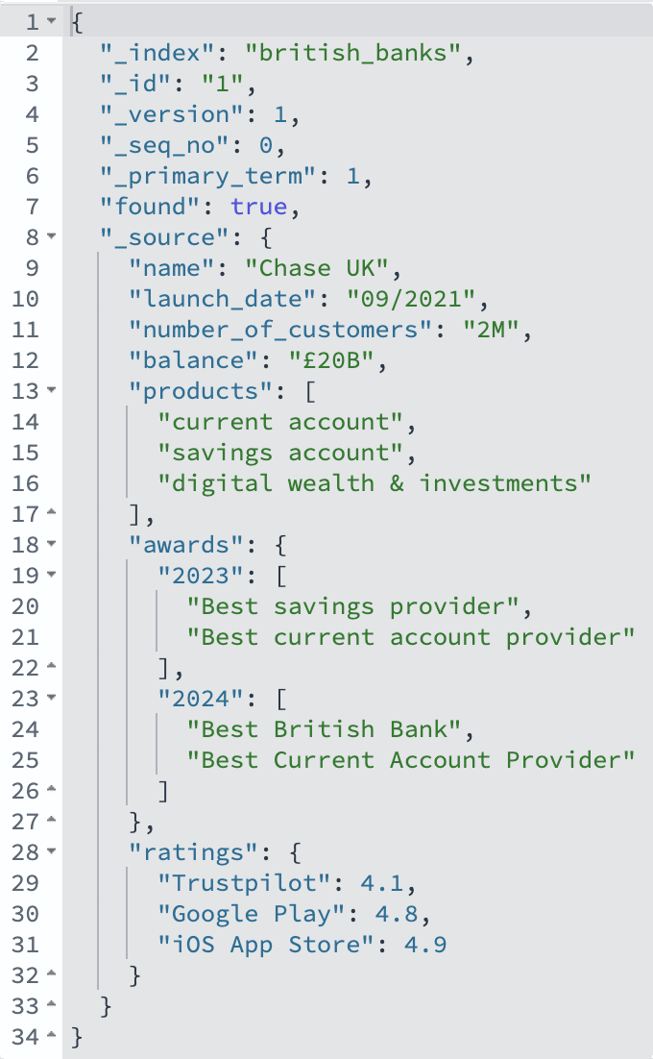


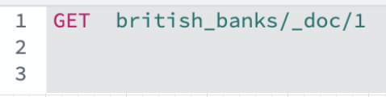

CHASE | AWARD-WINNING BANKING
Notes:
• Chase launched in the UK in Sept 2021
• Over 2M customers (Chase and Nutmeg)
• £20B in balances (Chase and Nutmeg)
• Current accounts, savings accounts, digital wealth & investments
• Winners at the British Bank Awards in several categories*
• 4.1 Trustpilot (Chase, Sep 2023)
• 4.8 Google - 4.9 iOS App Store Ratings (Chase, Sep 2023)

Slide 6


TERRAFORM 101
What? 🛠️ that lets you define(declare) what your infrastructure should look like, instead of manually setting everything up (a.k.a. IaC)
Why? To ensure consistency, repeatability, collaboration
How? Write a configuration files that describes the infra (VMs, storage, and networking). Terraform figures out how to make those changes.
“providers” - interact with various APIs - ☁️ (AWS, etc)
- 🫙 (Mysql, Postrges) - 🤓 Spotify / Dominos - your_next_best_tool - Elasticsearch | OpenSearch
“modules” - reuse/avoid repetitive declarations

Slide 7
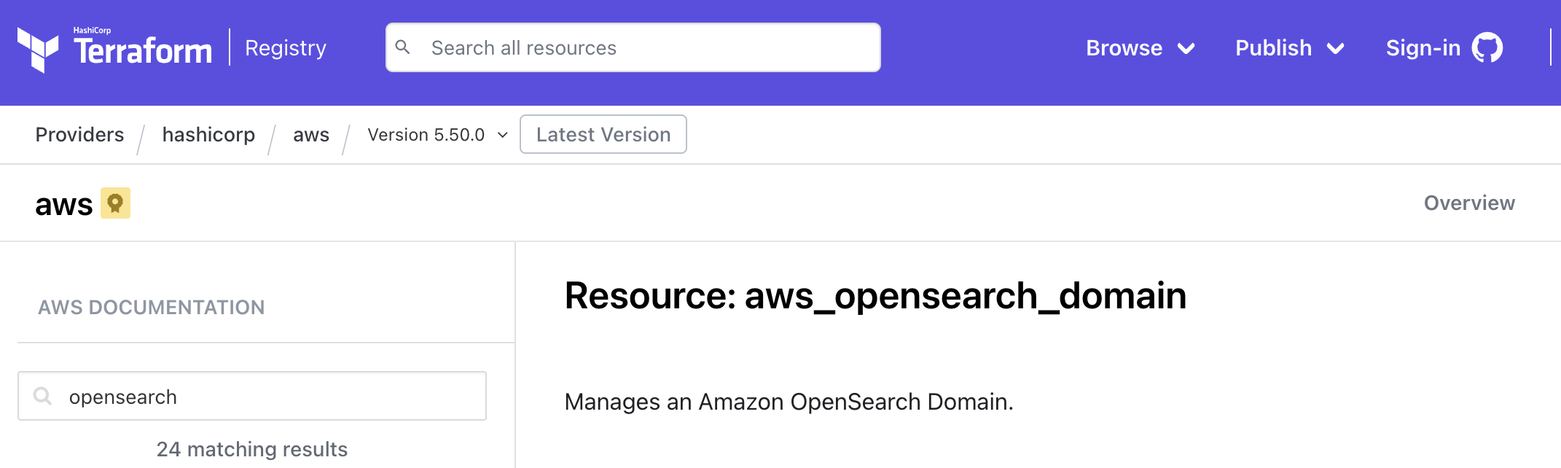
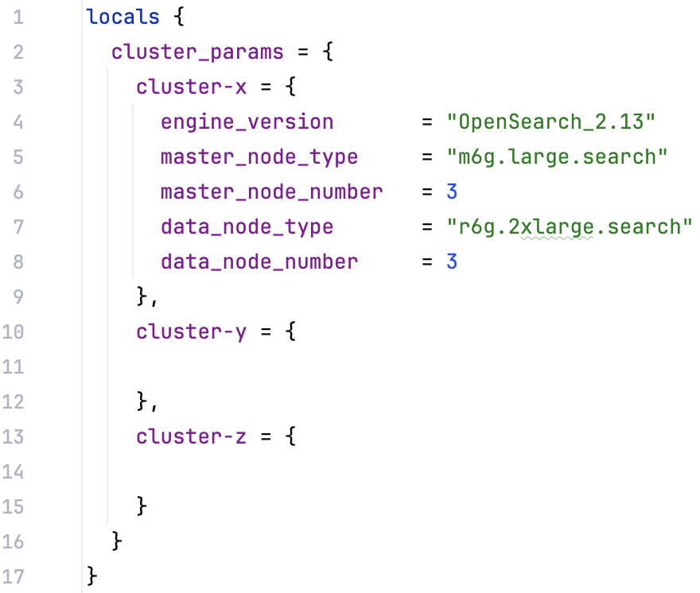
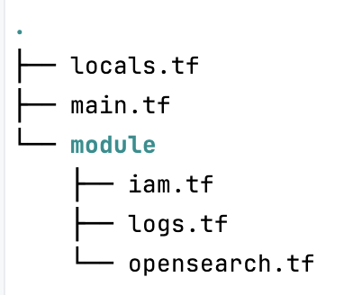
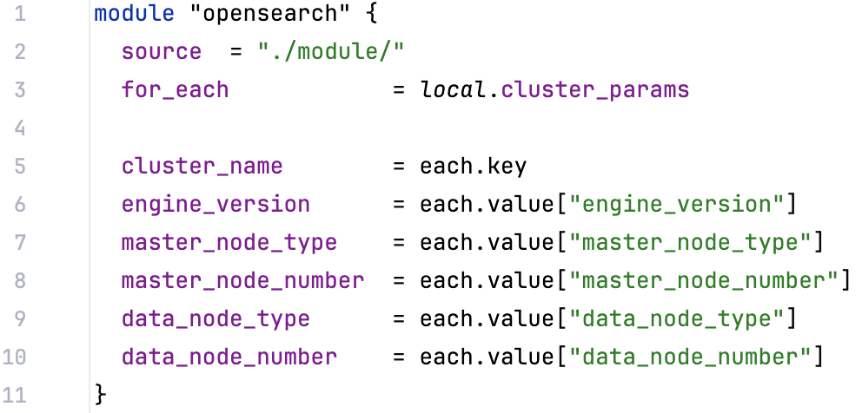

TERRAFORM 101 | AWS RESOURCE
OpenSearch cluster*
Cluster configuration | Data (_cat/allocation?v) | Environment
3 master nodes (r6g.xlarge.search) 24 data nodes (r6g.4xlarge.search) | 120TB 70B docs 14k shards 300 indicies / 10 index templates HOW many per day?? | Managed cluster Multi-AZ Engine version 2.11 Indexing Data Rate : 4k/12k (avg/peak) docs/second Average Search Latency: 10ms/500ms (avg/peak)
- IAM policies / SAML
- Number & type of master / data nodes
- EBS Options
- Engine Version - Warm/Cold storage
- Advanced options
CloudWatch OpenSearchService
Logs(audit/error/search_slow/index_slow)
- ....
Notes:
https://registry.terraform.io/providers/hashicorp/aws/latest/docs/resources/opensearch_domain
https://registry.terraform.io/providers/phillbaker/elasticsearch/latest/docs
https://registry.terraform.io/providers/opensearch-project/opensearch/latest/docs

Slide 8
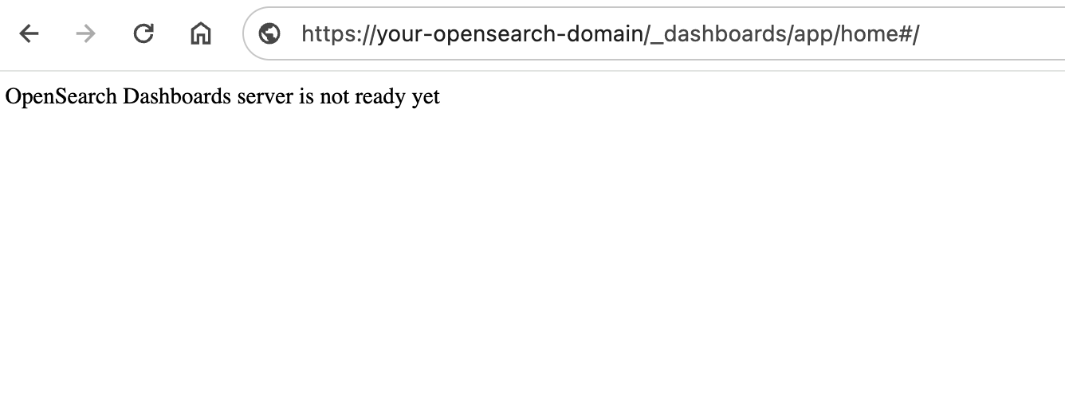
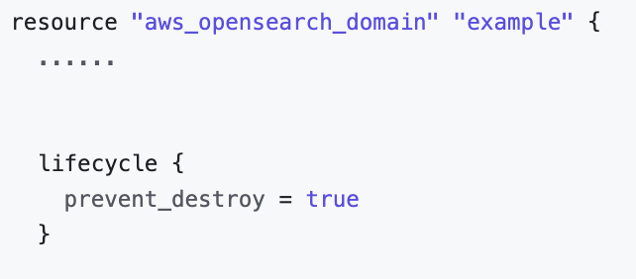

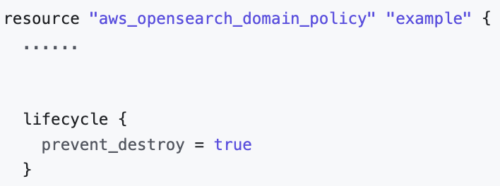
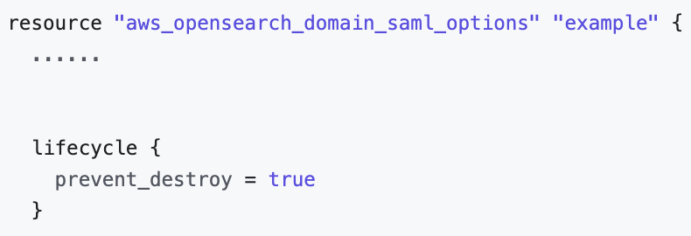

ENGINE UPGRADE
Migrations 😰
AWS is aware (2.13 improved 👏)
Workaround
Migrations are not ”backward” 🙀

Slide 9
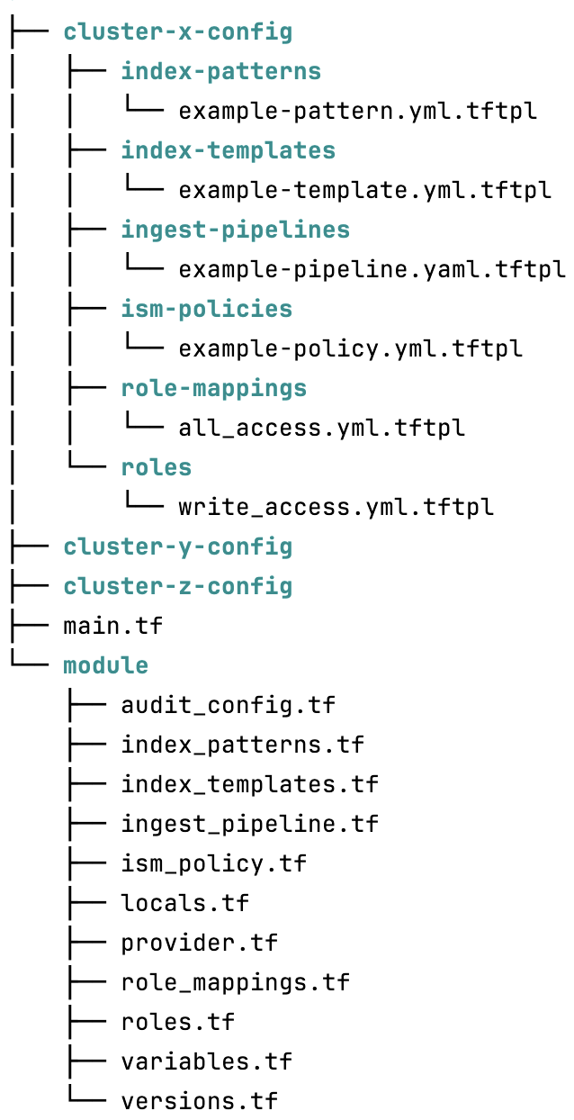
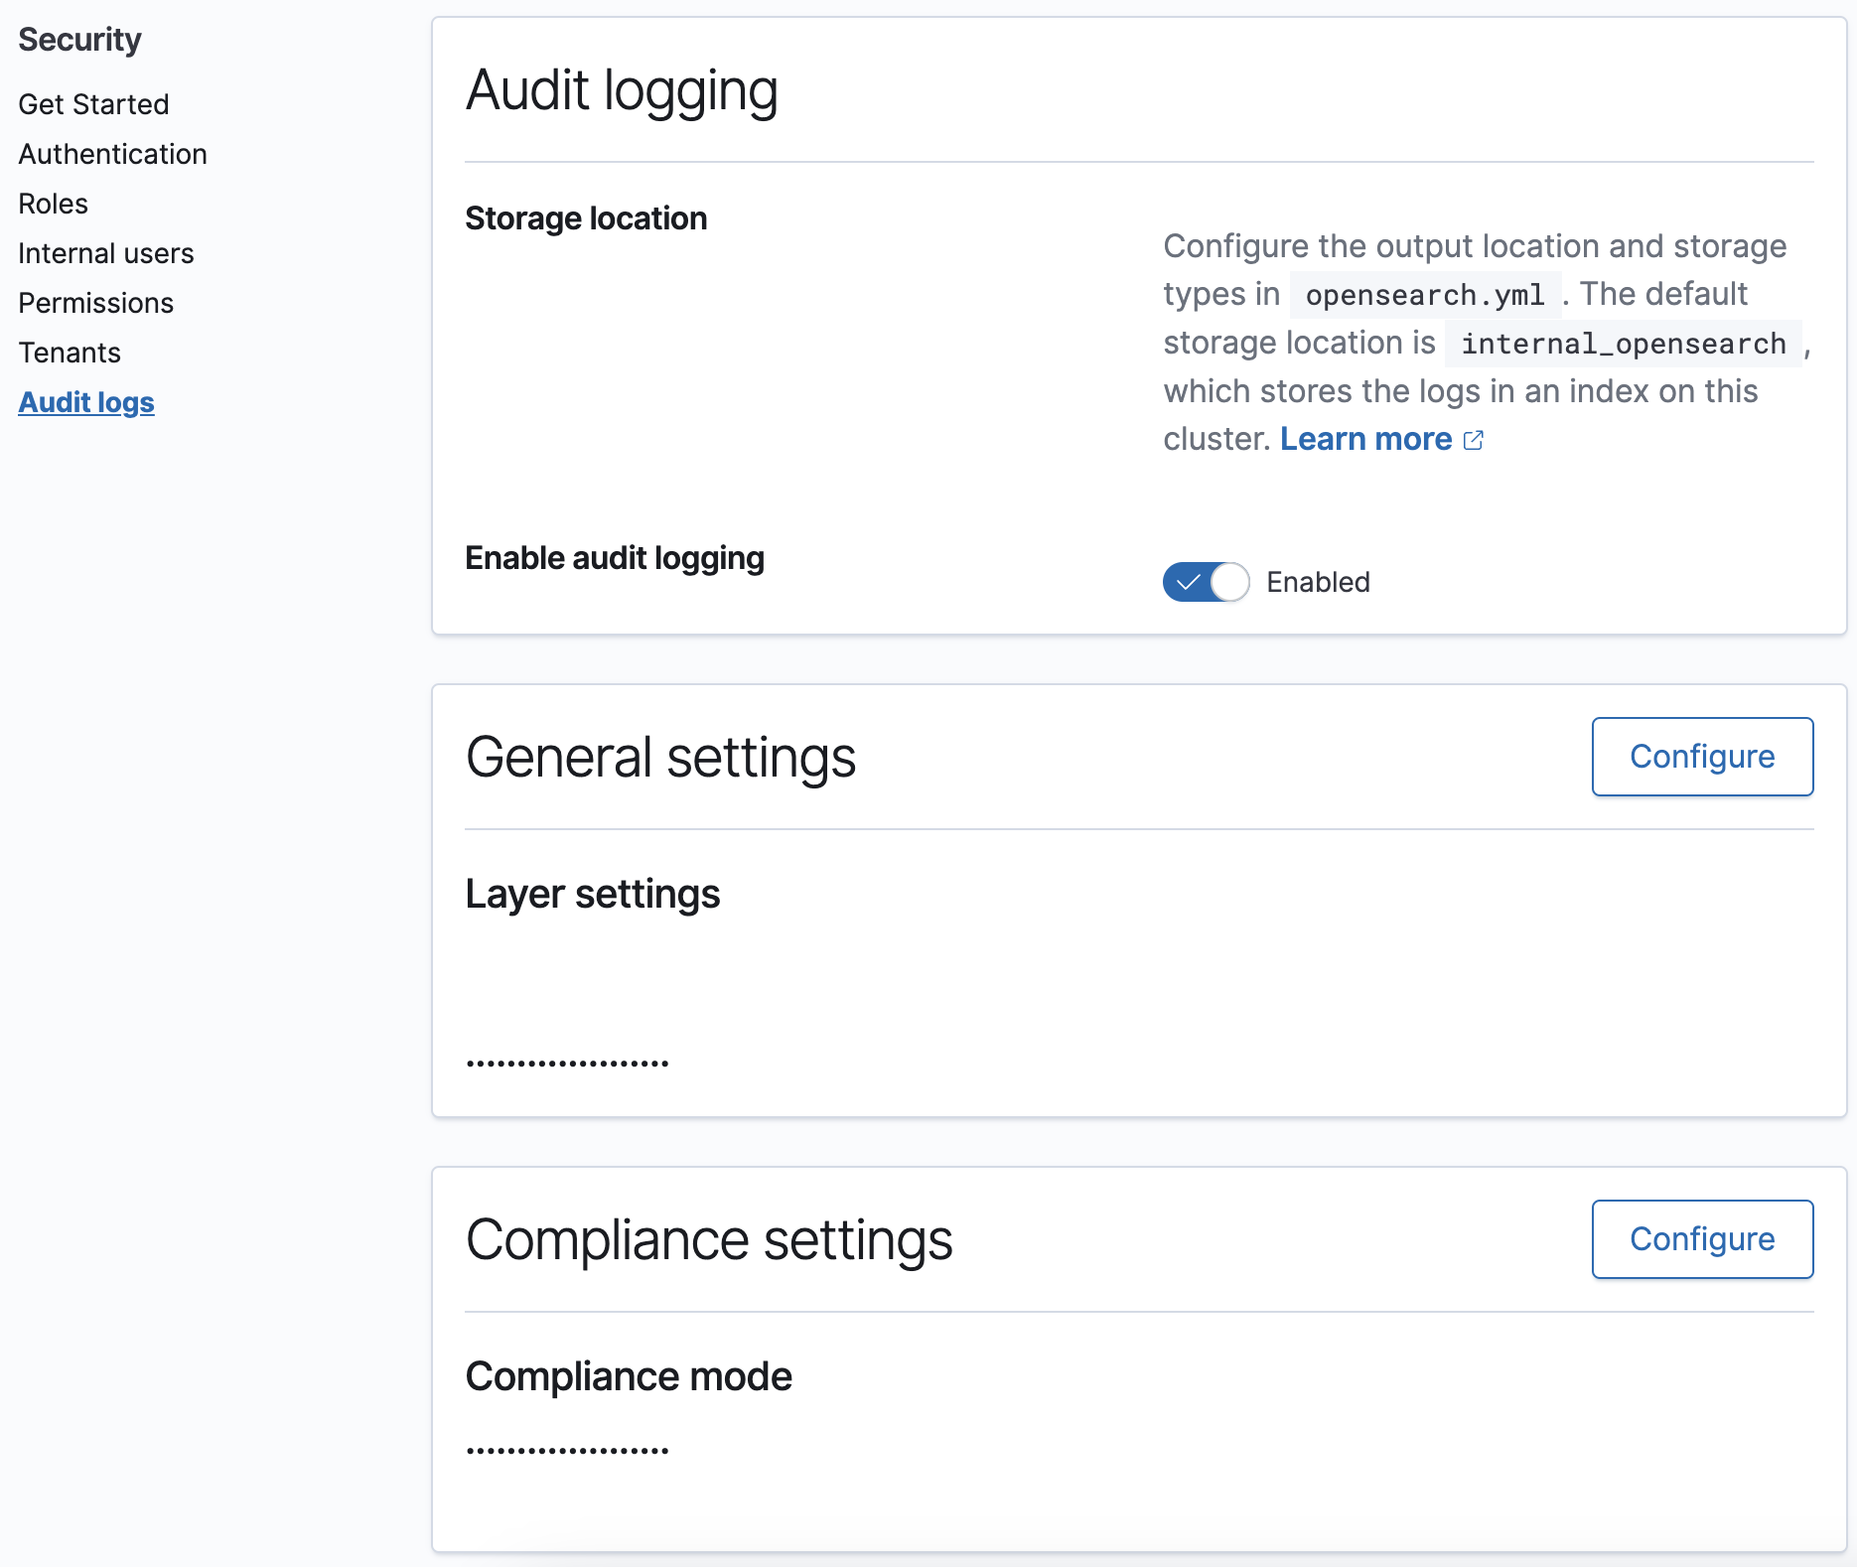
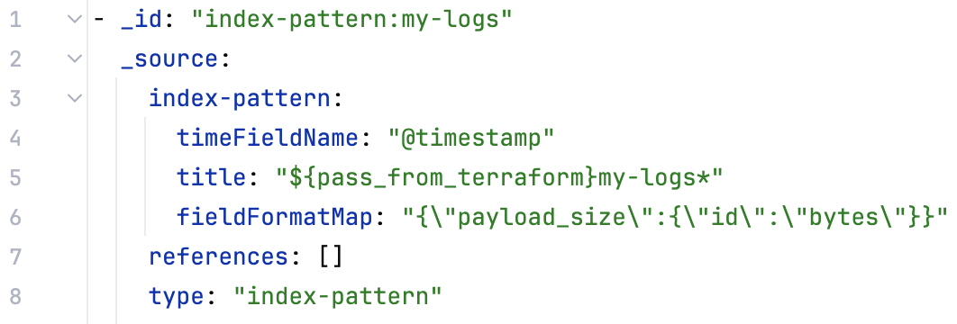
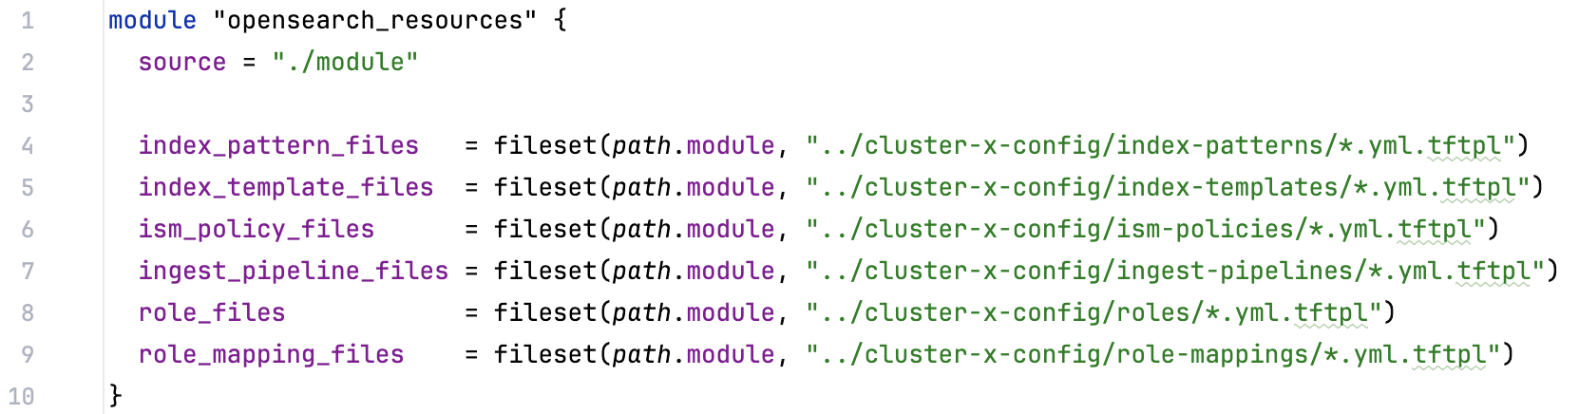
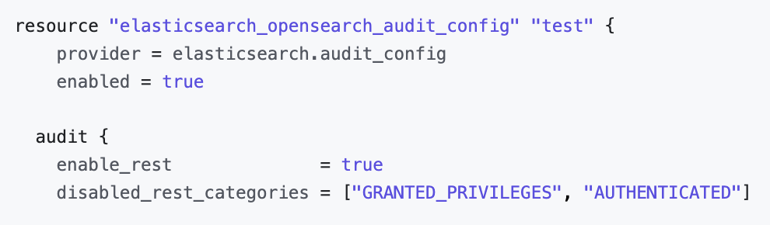
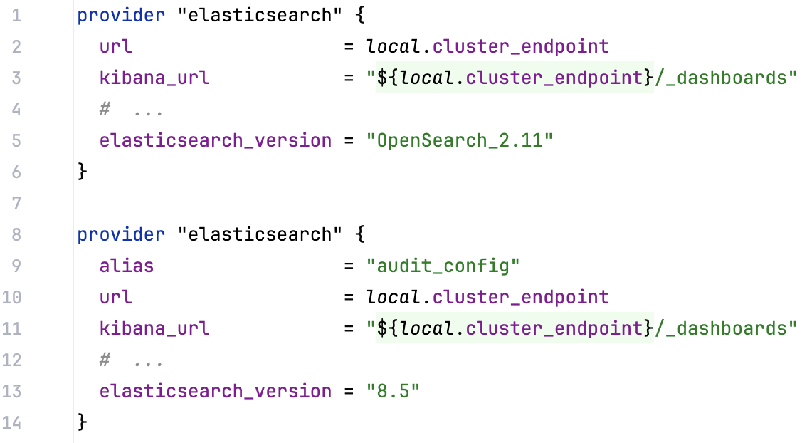
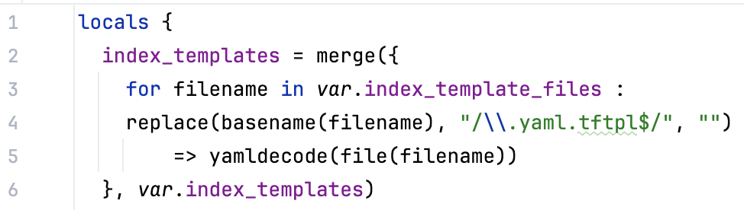
TERRAFORM 101 | OPENSEARCH RESOURCE
2 providers
.tftpl files
Downside
Notes:
https://registry.terraform.io/providers/hashicorp/aws/latest/docs/resources/opensearch_domain
https://registry.terraform.io/providers/phillbaker/elasticsearch/latest/docs
https://registry.terraform.io/providers/opensearch-project/opensearch/latest/docs

Slide 10


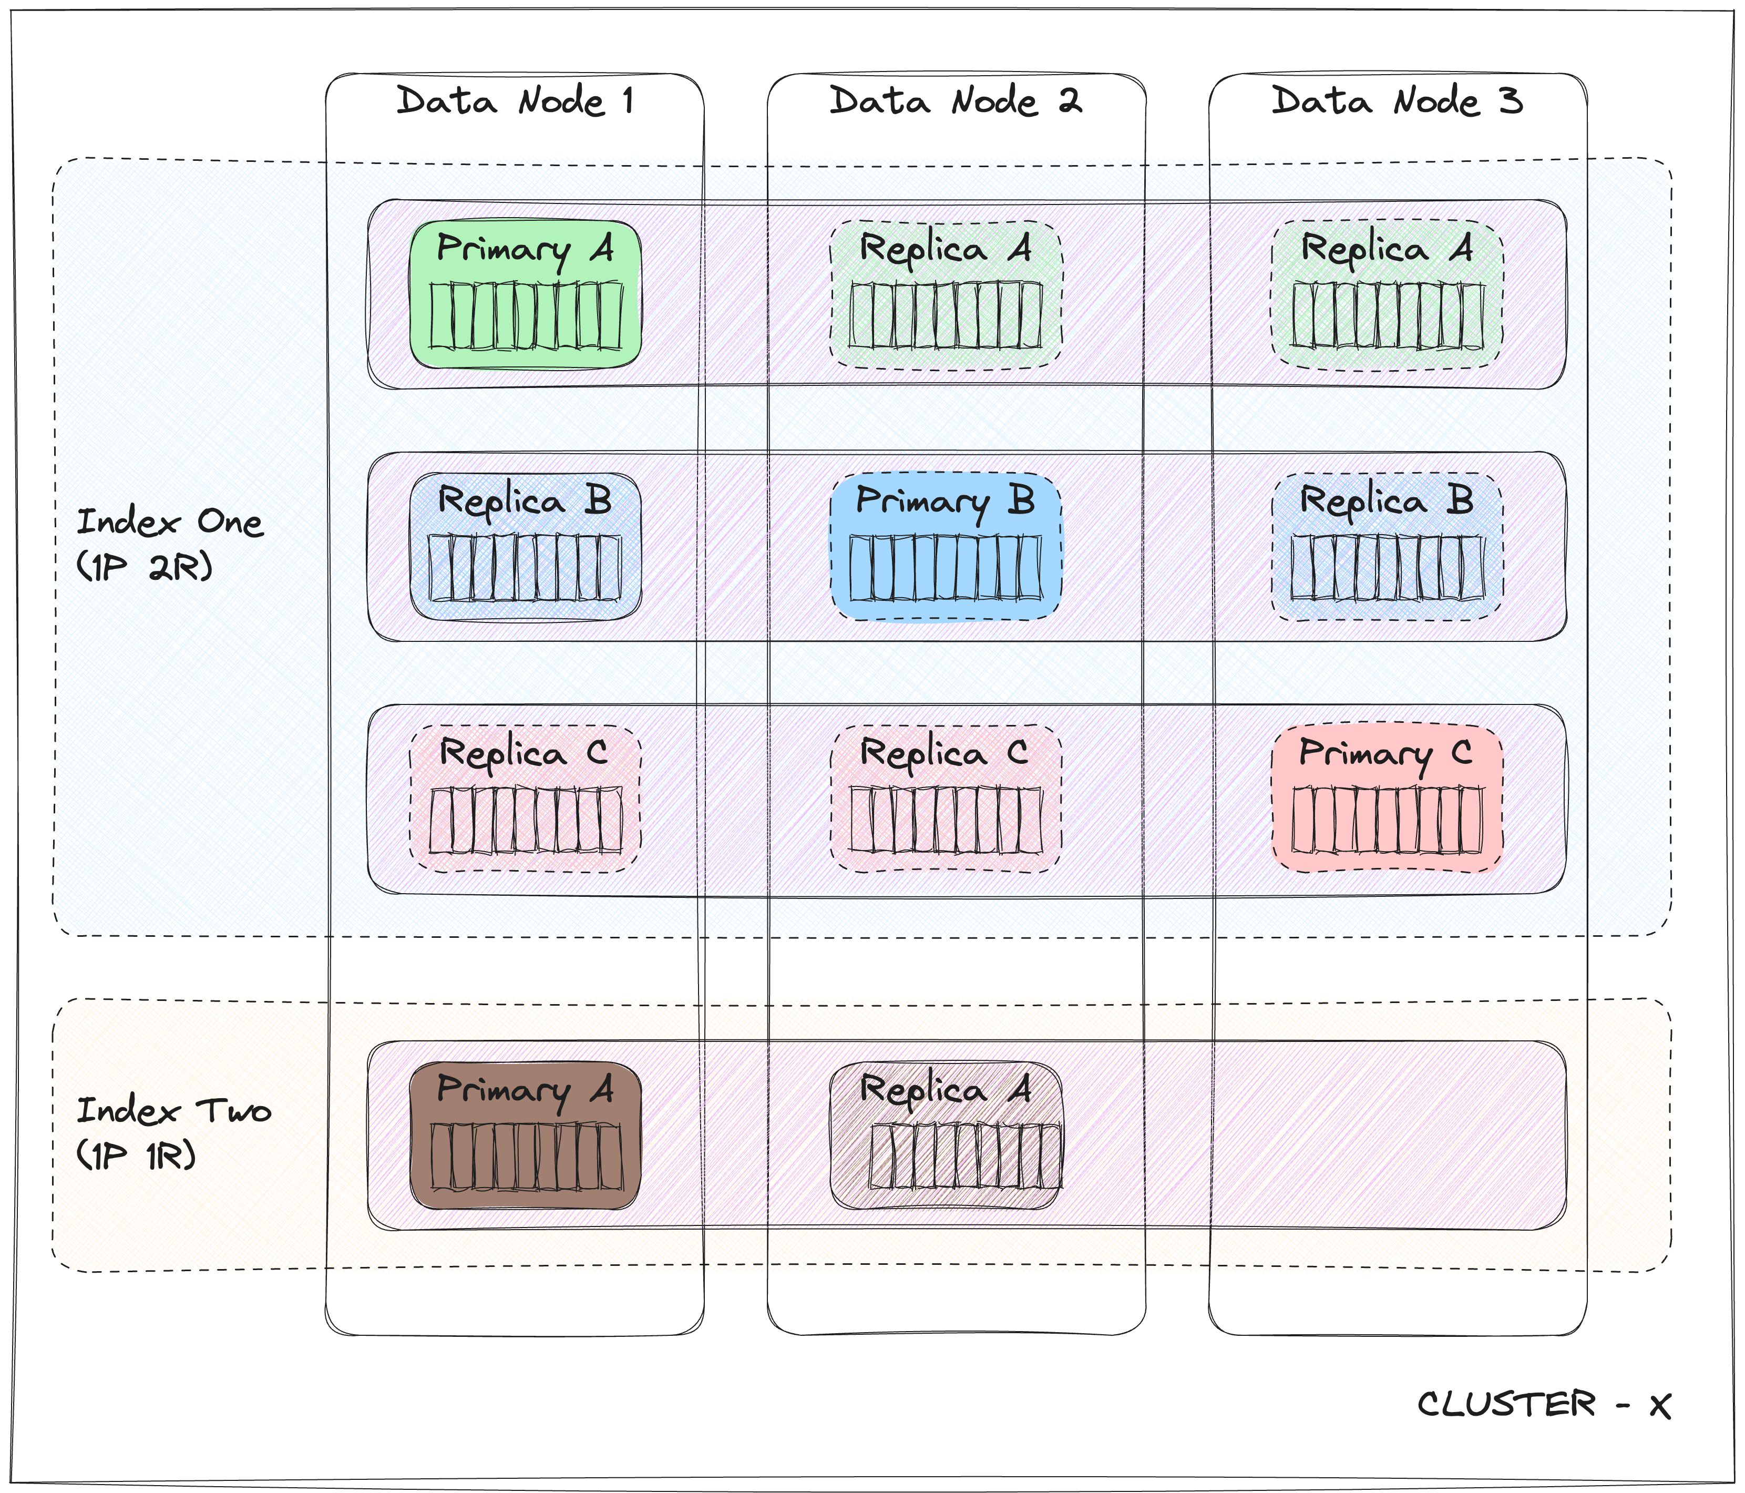
OPENSEARCH 101
Apache 2.0;
2021 Elasticsearch 🍴(version 7.10.2)
Workloads

Slide 11
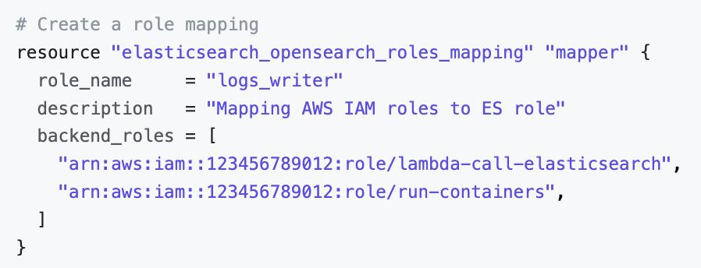
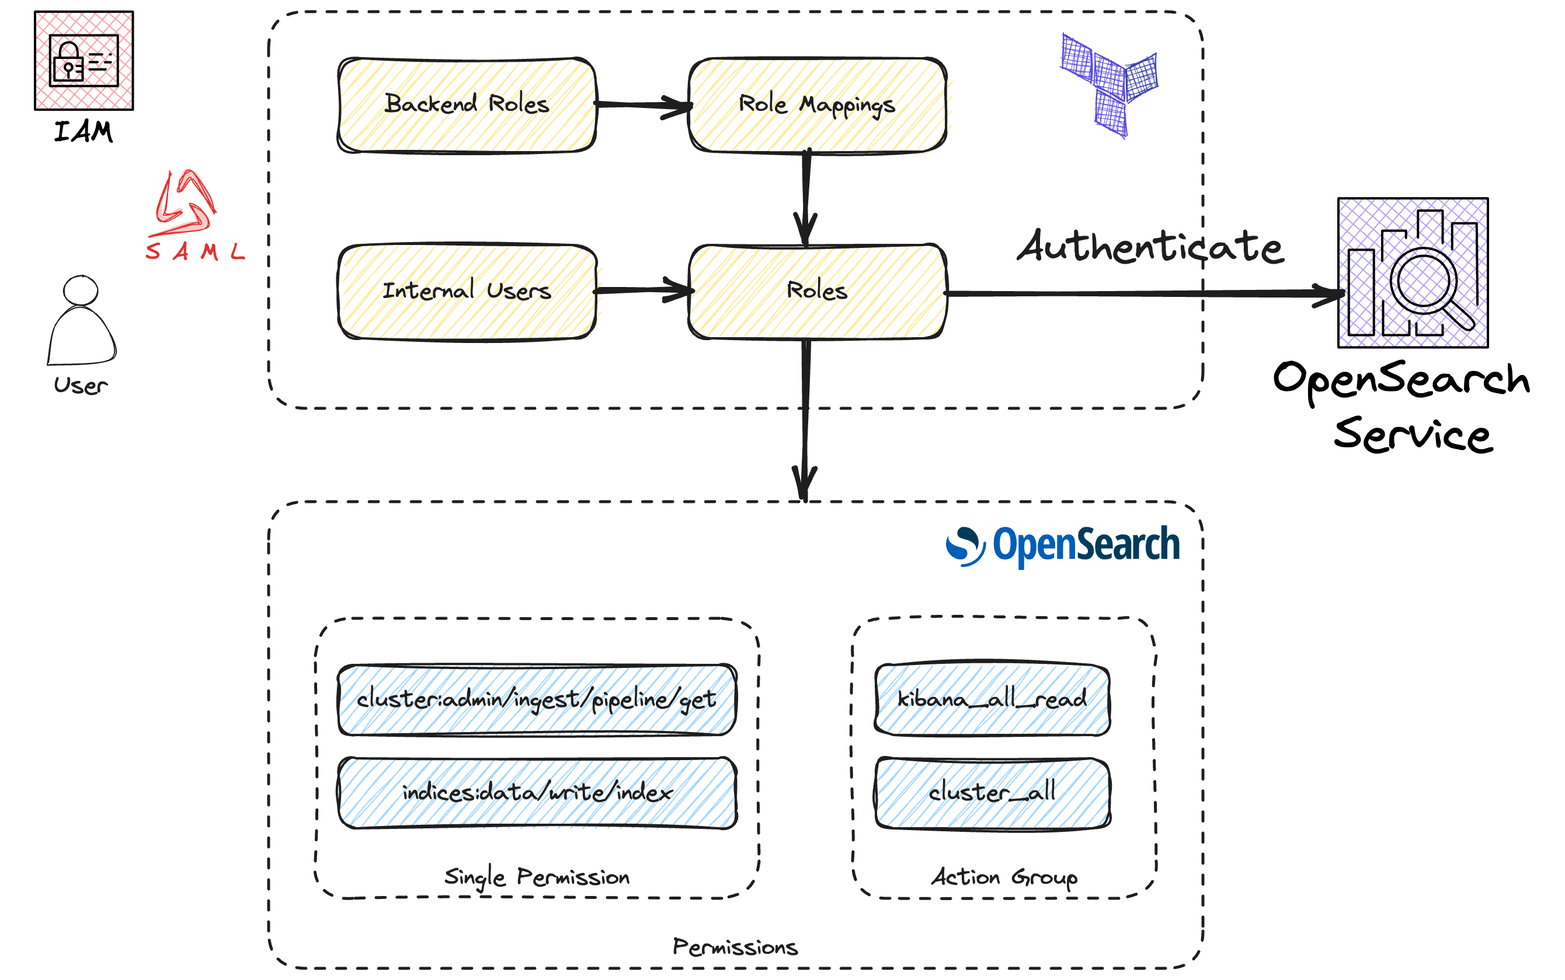
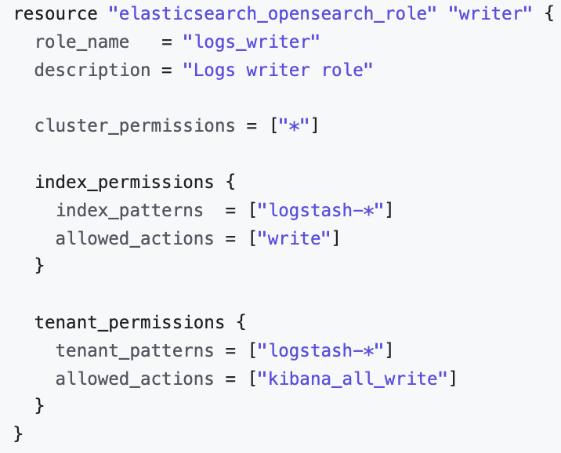
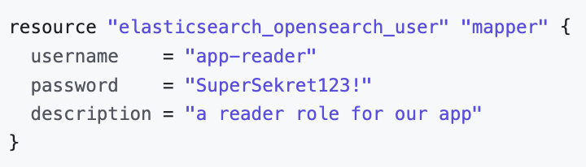
ROLES / ROLE-MAPPINGS(1/2)

Slide 12
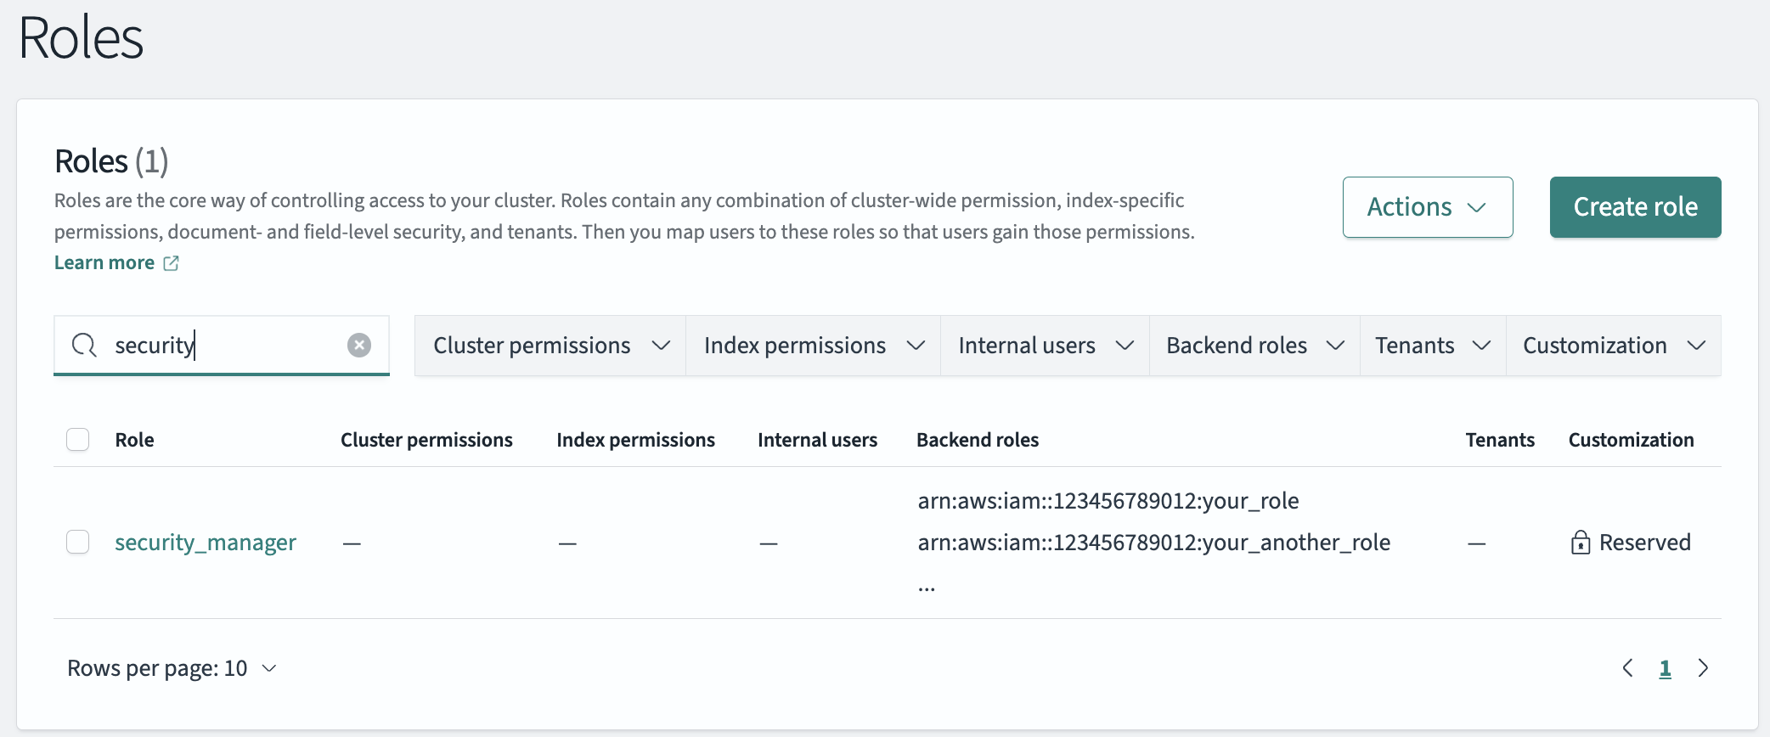
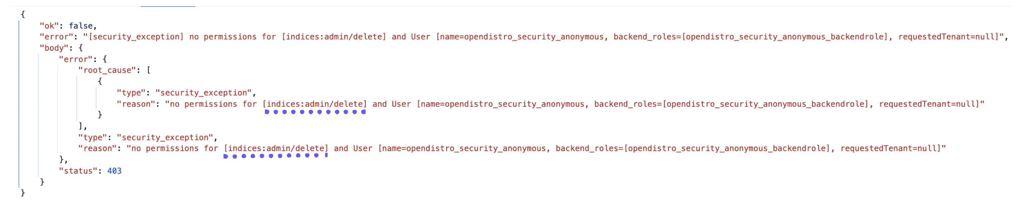
ROLES / ROLE-MAPPINGS(2/2)
field-level security 🤓
advanced settings granularity 😔
‘security_manager’ in terraform 😵
debugging 🔎

Slide 13
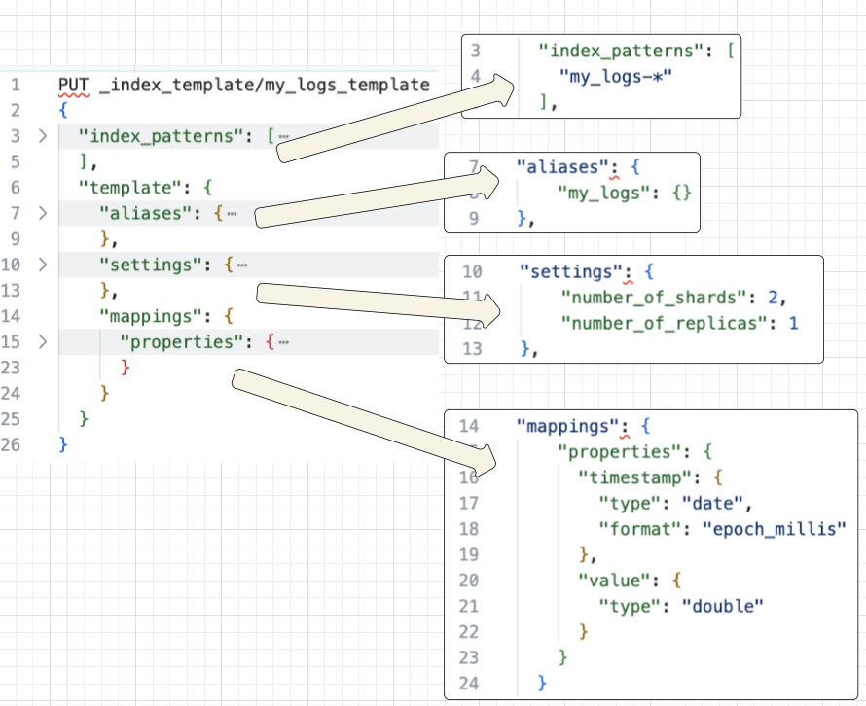
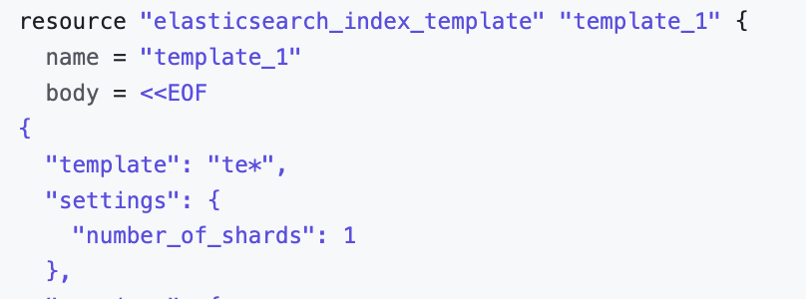
INDEX TEMPLATES
What? blueprints for creating indexes with predefined settings and mappings
Why? Copying the same settings across various indexes, especially one by one, is tedious and sometimes error-prone;
We are aiming for settings to be homogenous across the organization.
How? Defining a template with a schema up front, a new index will be implicitly created from this schema if the index name matches the template
2 categories: composable and component
* Index patterns
* Alias
Settings
Refresh interval
Pipelines (more on it later)
Shard size / Number of replicas
Even matching | shards are not dynamic
Notes:
- `Mappings` — creating a schema definition. Data that is stored usually has multiple data types associated with its fields, such as `text`, `keyword`, `long`, `date`, and so on. Elasticsearch consults the mapping definitions to apply appropriate rules for analyzing incoming data before storing it for efficient and effective searching.
- `Settings` - set of configuration settings, such as number of shards and replicas, refresh rate, compression codec, and others. _Dynamic settings_ can be tweaked on a live index at runtime. _Static settings_ are applied to an index in a non-operational mode.
`Aliases` - alternate names given to indexes. An alias can point to a single or multiple indexes. For example, an alias named my_cars_aliases could point to all car indexes. We can also execute queries on aliases as if we are running them on individual aliases.
https://opster.com/guides/opensearch/opensearch-data-architecture/index-templating-in-opensearch-how-to-use-composable-templates/
https://registry.terraform.io/providers/phillbaker/elasticsearch/latest/docs/resources/index_template

Slide 14
INDEX TEMPLATES | MAPPING
Mapping (should I have examples)
Default is UUID not practical for this use-case
Dynamic: true./ false / runtime
@timestamp: date_nanos
doc_values
flat_object type
match_only_text
Metadata field size _size / painless
TODO –STACKTRACE : 56 terms
Notes:
- `Mappings` — creating a schema definition. Data that is stored usually has multiple data types associated with its fields, such as `text`, `keyword`, `long`, `date`, and so on. Elasticsearch consults the mapping definitions to apply appropriate rules for analyzing incoming data before storing it for efficient and effective searching.
- `Settings` - set of configuration settings, such as number of shards and replicas, refresh rate, compression codec, and others. _Dynamic settings_ can be tweaked on a live index at runtime. _Static settings_ are applied to an index in a non-operational mode.
`Aliases` - alternate names given to indexes. An alias can point to a single or multiple indexes. For example, an alias named my_cars_aliases could point to all car indexes. We can also execute queries on aliases as if we are running them on individual aliases.
https://opster.com/guides/opensearch/opensearch-data-architecture/index-templating-in-opensearch-how-to-use-composable-templates/
https://registry.terraform.io/providers/phillbaker/elasticsearch/latest/docs/resources/index_template

Slide 15
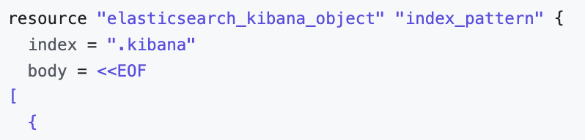
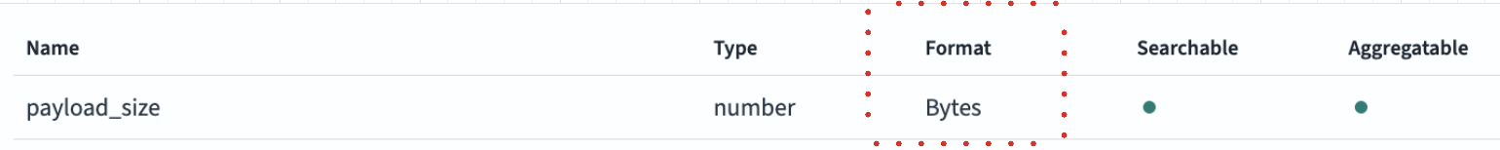
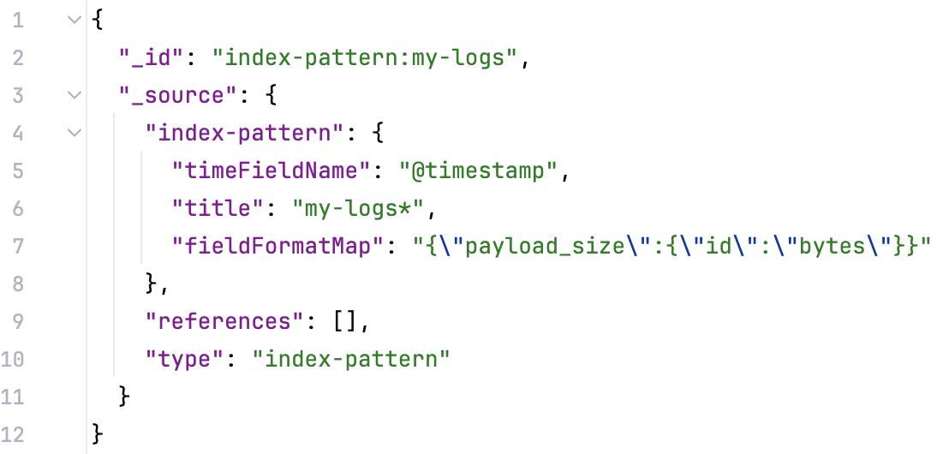
INDEX PATTERNS
‘.kibana’ index alias
refresh
Type: number / Format: Bytes
Notes:
- `Mappings` — creating a schema definition. Data that is stored usually has multiple data types associated with its fields, such as `text`, `keyword`, `long`, `date`, and so on. Elasticsearch consults the mapping definitions to apply appropriate rules for analyzing incoming data before storing it for efficient and effective searching.
- `Settings` - set of configuration settings, such as number of shards and replicas, refresh rate, compression codec, and others. _Dynamic settings_ can be tweaked on a live index at runtime. _Static settings_ are applied to an index in a non-operational mode.
- `Aliases` - alternate names given to indexes. An alias can point to a single or multiple indexes. For example, an alias named my_cars_aliases could point to all car indexes. We can also execute queries on aliases as if we are running them on individual aliases.
https://opensearch.org/docs/latest/field-types/supported-field-types/match-only-text/

Slide 16
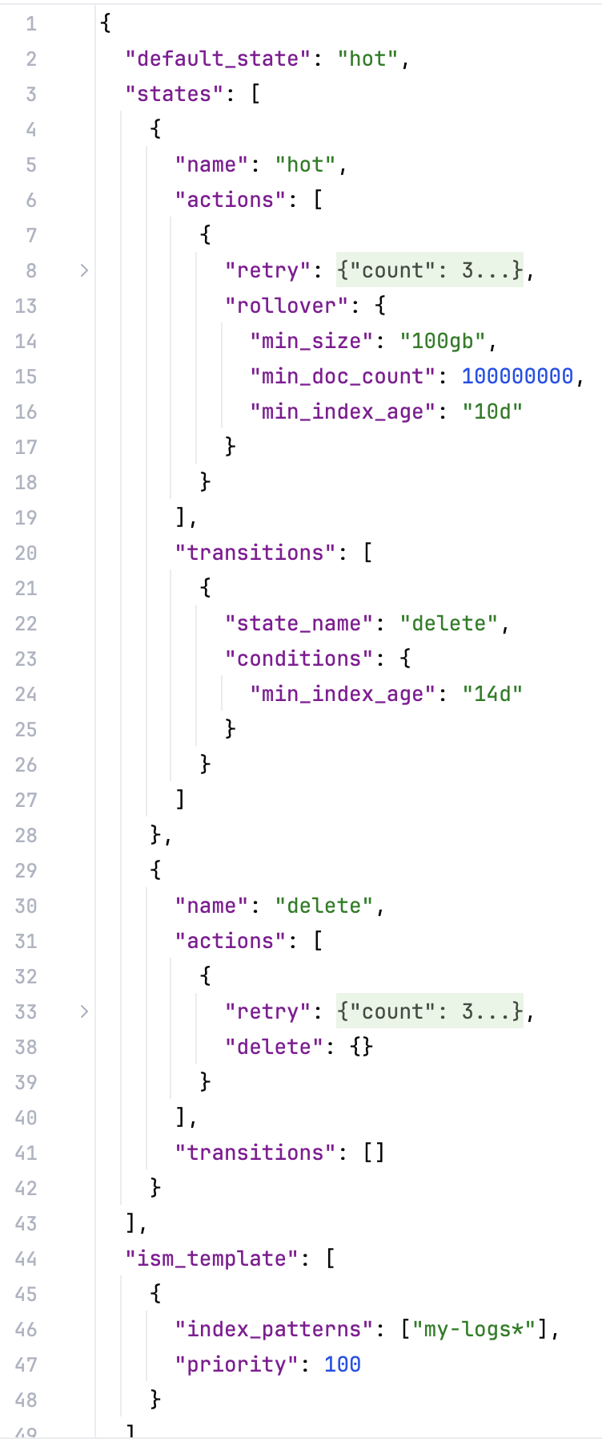
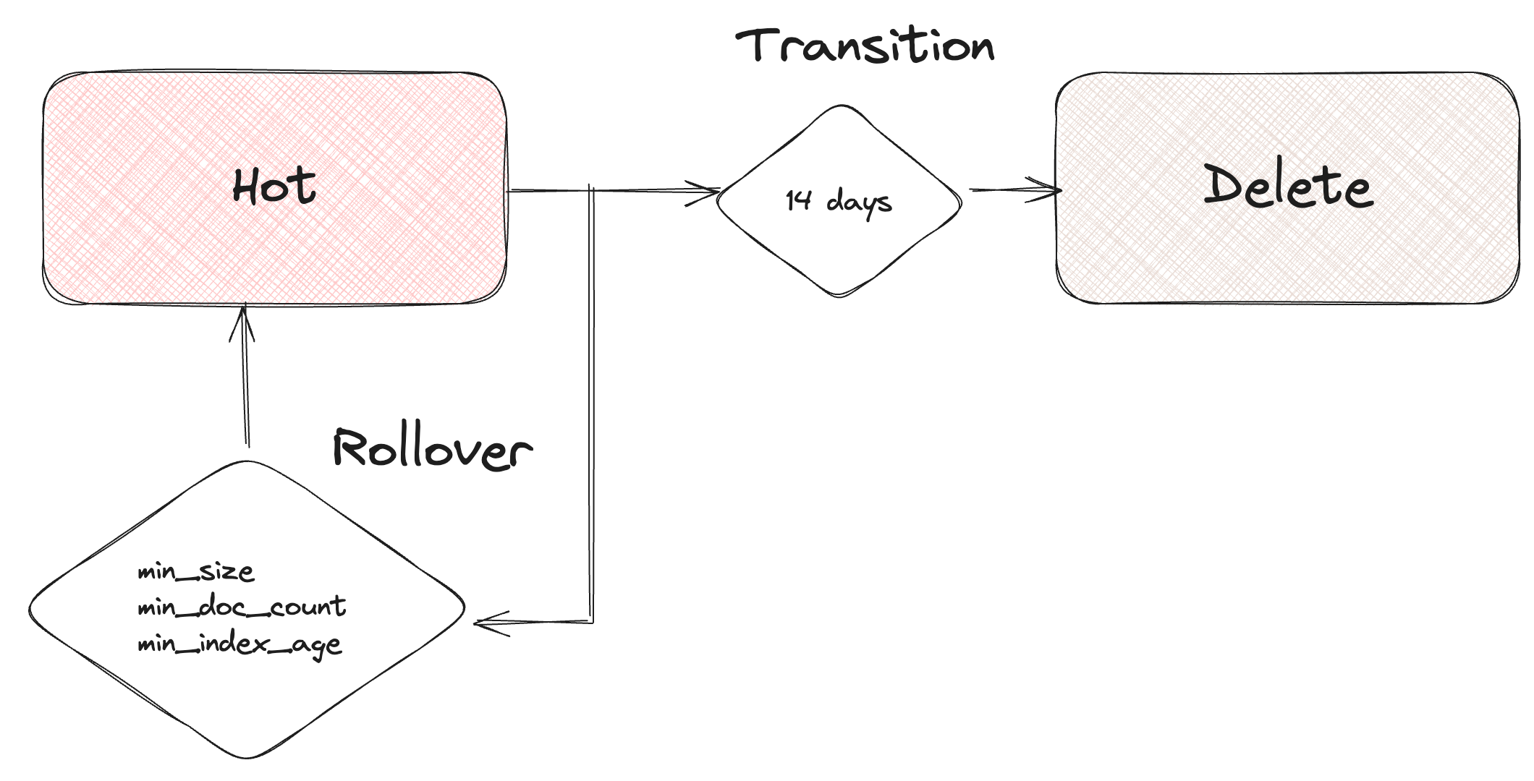
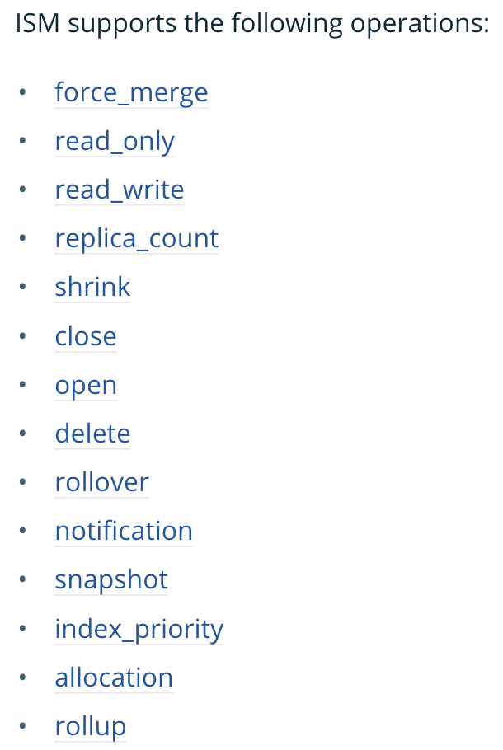
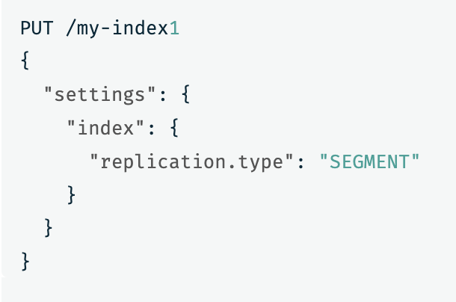
ISM / ILM POLICIES
Hot – fastest/costly im4gn MRC-6g
Mixed Hot/Warm OR1*
UltraWarm
Cold (S3)
Look after the rollover
Notes:
https://opensearch.org/docs/2.14/im-plugin/ism/policies/#rollover
https://opensearch.org/docs/2.14/im-plugin/ism/policies/#transitions
https://opensearch.org/docs/latest/tuning-your-cluster/availability-and-recovery/segment-replication/index/
https://docs.aws.amazon.com/opensearch-service/latest/developerguide/ism.html#ism-diff
https://docs.aws.amazon.com/opensearch-service/latest/developerguide/ism-tutorial.html

Slide 17
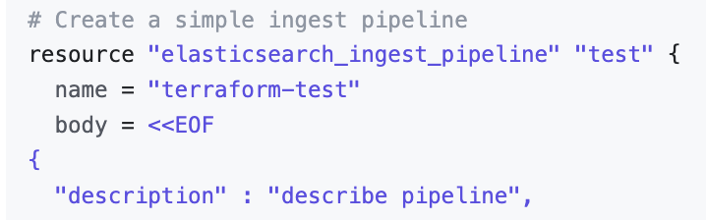
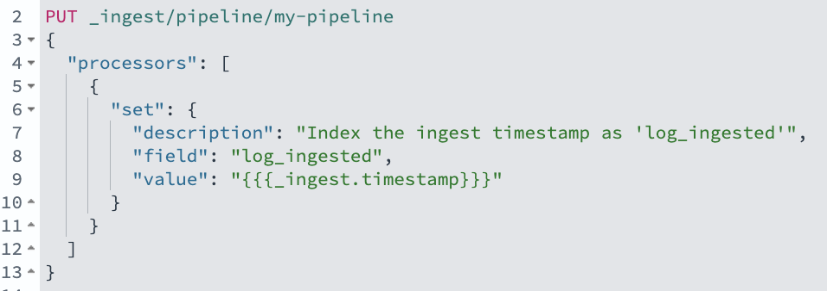
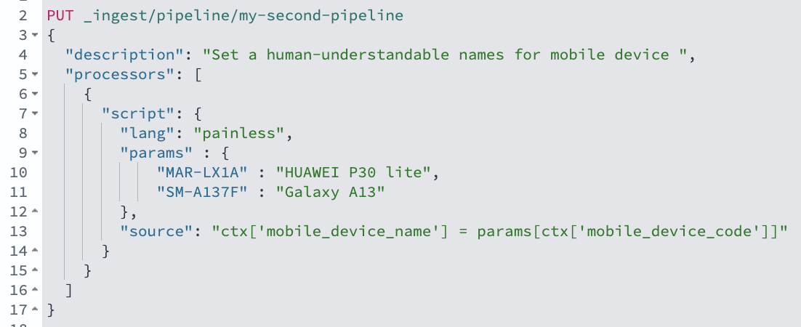
INGEST PIPELINES
Enrichment 💰
Notes:
Data Cleaning: Removing unwanted fields, fixing data inconsistencies, and converting data types.
Data Enrichment: Adding additional information to documents based on pre-defined rules or external sources.
Data anonymization: Obscuring sensitive data before storing it in OpenSearch
https://www.elastic.co/guide/en/elasticsearch/reference/8.13/ingest.html#template-snippets
https://registry.terraform.io/providers/phillbaker/elasticsearch/latest/docs/resources/ingest_pipeline

Slide 18
CHECKLIST | BEST PRACTICES
### Managed clusters - best-practices mini-checklist
- Deploy, monitor, adjust
- use _bulk API
- use 3 Dedicated cluster manager nodes
- select 3 zones with Multi-AZ
- set a template and use 2 replicas
- Free storage `>= 25%`
- Shards:vCPU = `1:1.5`
- Shard size = 50GB(logs) / 30 for search
- Max shards per node = 25 * JVM heap size
- Total shard count < 30K

Slide 19
THANK YOU

